Slide 1
SUPPLY CHAIN ANALYSIS
CDACL-003-Supply Chain Analysis

Slide 2
Data Access and Tools Used
Received database access credentials including username,and password from Datamites.
Used these credentials to connect to the MySQL database using a SQL interface (My SQL Workbench)
Accessed and explored the dataset through SQL queries to understand the structure and content
Verified that the dataset was already clean and ready for use
No data cleaning was required, as the dataset had no missing or inconsistent values

Slide 3



Total Cost of Cosmetics
"The total manufacturing cost of cosmetics products is shown here, helping assess how much the company spends on this product line."
Total Cost of Haircare
"This card represents the total production cost of all hair care items."
Total Cost of Skincare
"Shows the total cost associated with manufacturing skincare products."

Slide 4



Revenue From Cosmetics
"This value reflects how much revenue was generated from cosmetics sales."
Revenue From Haircare
"Indicates the revenue earned through hair care product sales."
Revenue From Skincare
"Displays the total revenue collected from skincare products."

Slide 5



Total Cost (All Product)
"This is the combined cost of manufacturing across all product types."
Total Revenue (All Product)
"Represents the overall sales revenue from all product categories."
Total Profit (All Product)
"Calculated as total revenue minus total cost — this is the total profit earned across all products."

Slide 6

Profit Margin %
"Shows how much percentage of the revenue is retained as profit. For example, a 90% margin means 90 SAR profit on every 100 SAR earned."

Slide 7
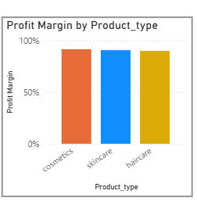
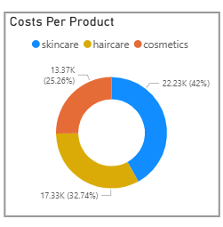
Profit Margin % By Categories
"The clustered column chart displays the profit margin percentage across different product categories. As shown, Cosmetics leads with the highest profit margin at around [91.72%%], followed by Hair Care and Skincare.
Cost Per Product
"This donut chart displays the total cost distribution across product categories. It highlights which products consume the most manufacturing or supply resources."

Slide 8
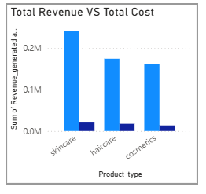
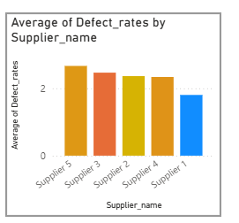
Revenue vs Profit Efficiency by Product
The Clustered chart visually compares how much each product category earns (revenue) vs how much it costs (manufacturing cost) — helping identify which categories are most or least profitable
Avg Defect Rate By Supplier
"This chart displays the average defect rate of products delivered by each supplier. It highlights quality performance, with lower percentages indicating better reliability."

Slide 9
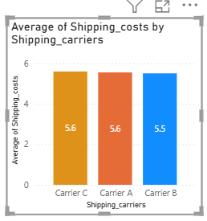
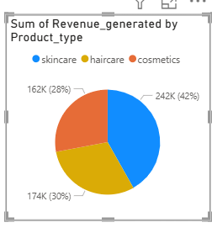
Average Shipping Cost by Carrier
"This chart compares the average shipping cost per delivery across different carriers. It highlights which shipping providers are more cost-effective."
Sum of Revenue Generated by Each Product Type
"This chart displays the total revenue generated by each product category, highlighting which product lines contribute most to overall sales."

Slide 10
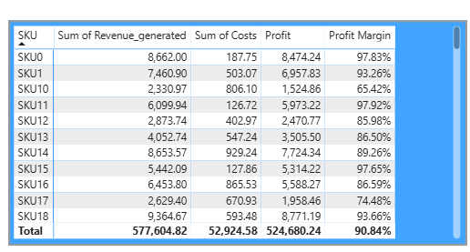
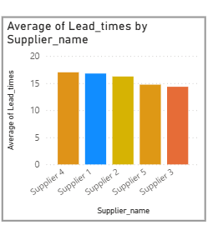
Detailed Product Performance by SKU
"This matrix provides a detailed view of each product SKU, showing its revenue, cost, profit, and profit margin. It helps us identify which individual products perform best financially and which may need attention."
Avg Lead Time By Supplier
"This chart shows the average number of days each supplier takes to deliver goods. It helps evaluate supplier performance based on delivery speed."

Slide 11
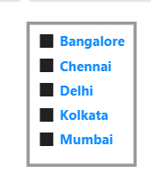

Slicers by Location and Product
"Two slicers are provided to filter the data by Location and Product Type, enabling quick and interactive analysis based on geographic area and product categories."

Slide 12
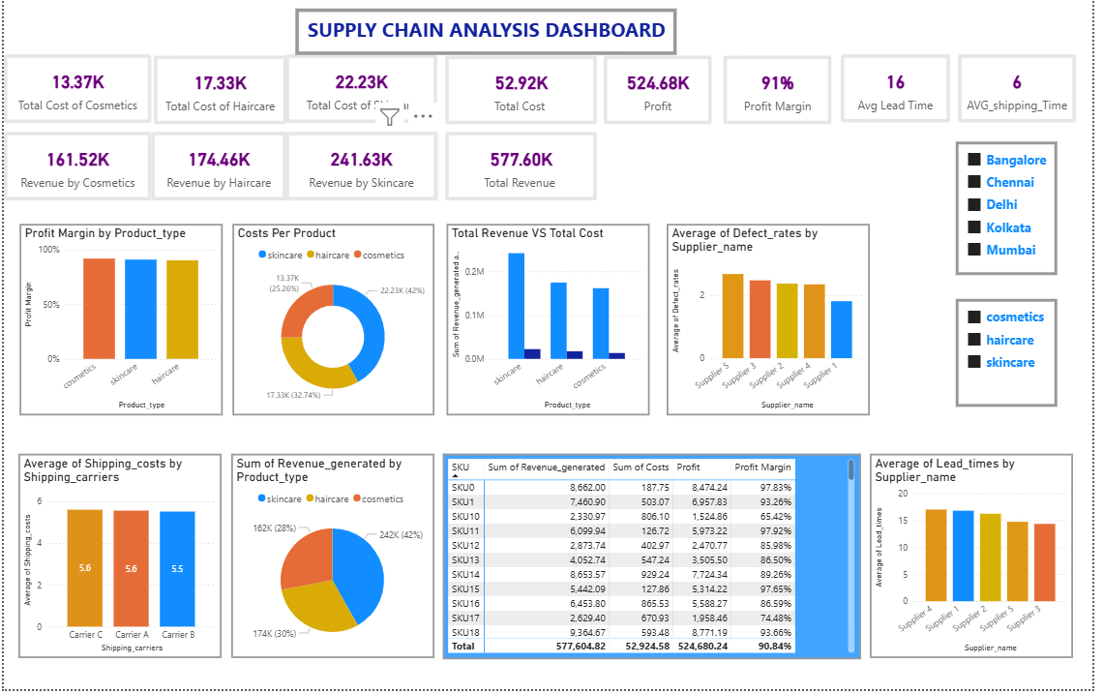
DASHBOARD

Slide 13
DASHBOARD EXPLANATION
This dashboard provides a comprehensive analysis of supply chain performance across product categories. It highlights key financial metrics including total revenue, total cost, profit, and profit margin by product type, helping identify the most profitable categories. Visuals such as bar and donut charts compare revenue and cost distribution, while detailed KPIs track average lead time, shipping time, and defect rates to assess supplier and logistics efficiency. A matrix at the SKU level allows in-depth analysis of individual product performance. Overall, the dashboard delivers clear insights into sales performance, cost control, and supply chain quality, enabling data-driven decision-making for improved business efficiency.

